Slide 1
EMPLOYEE PERFORMANCE ANALYSIS USING EXCEL
PRESENTED BY : C.P.SUSHMITHA
REGISTER NO : 2213331096074
USERNAME : asunm13332213331096074
DEPARTMENT : COMMERCE
COLLEGE : BHARATHI WOMEN’S COLLEGE

Slide 2
PROJECT TITLE
Employee Performance Analysis
Using Project

Slide 3
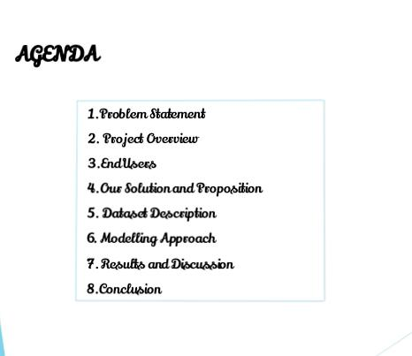

Slide 4
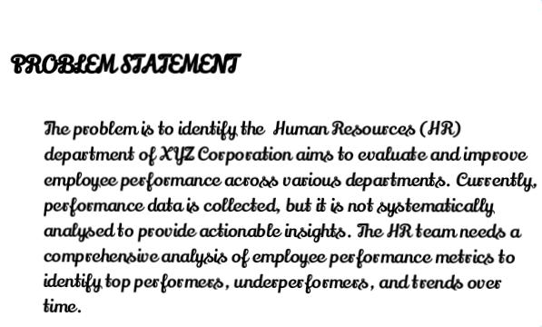

Slide 5
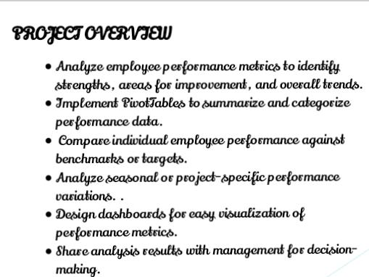

Slide 6


Slide 7
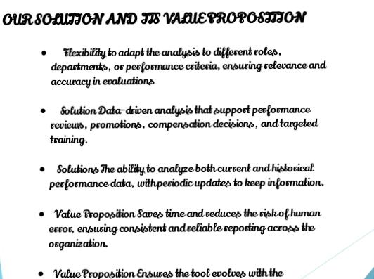

Slide 8
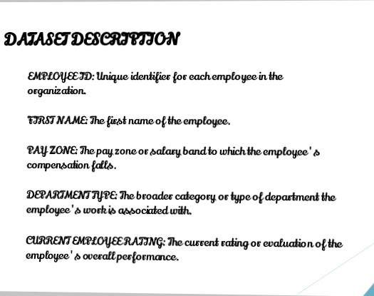

Slide 9
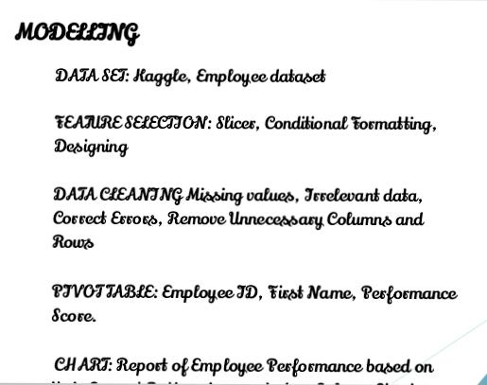

Slide 10
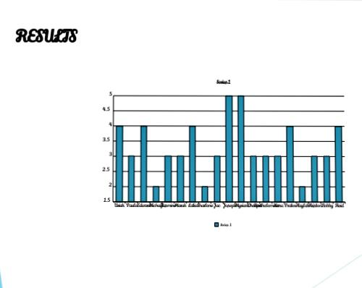

Slide 11
